Slide 1
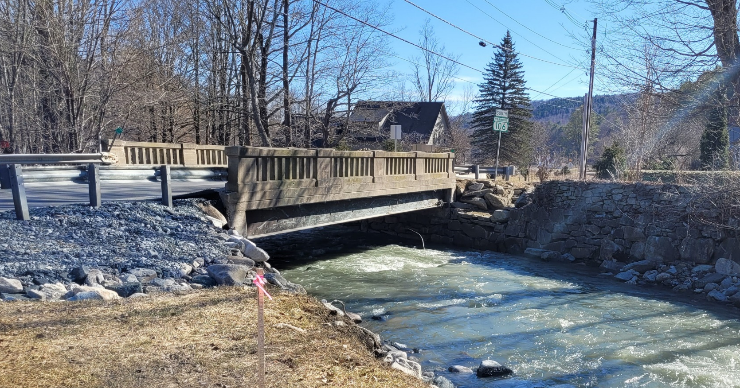

Reading ER P23-1(404)
Selectboard Presentation
VT 106 – Bridge #12 over North Branch Black River
September 9, 2024

Slide 2

Introductions
Cory Burrall, P.E.
VTrans Structures Project Manager
Fianna Barrows, P.E.
VTrans Structures Lead Design Engineer
Jeff DeGraff, P.E.
VTrans Hydraulics Project Engineer

Slide 3
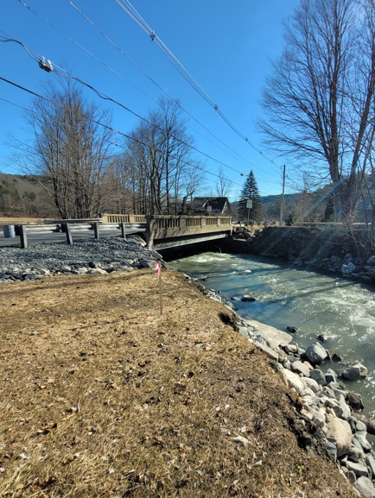
Agenda
Provide an update to project development
Project overview and existing conditions
Hydraulic analysis
Proposed design and plans
Traffic management plan
Project schedule and timeline
Provide an opportunity to ask questions and voice any concerns

Slide 4
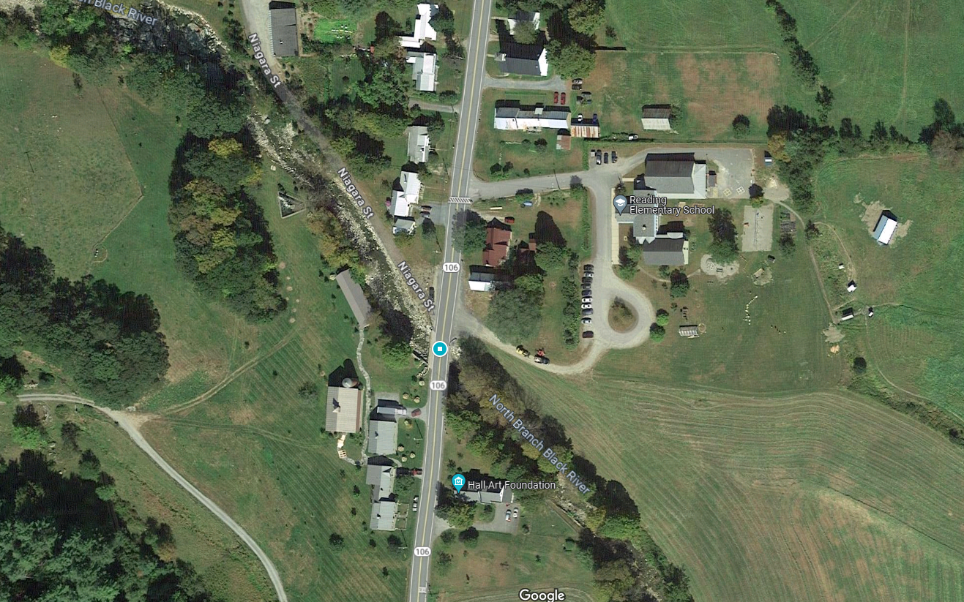
Bridge 12
Project Location
Location Map

Slide 5
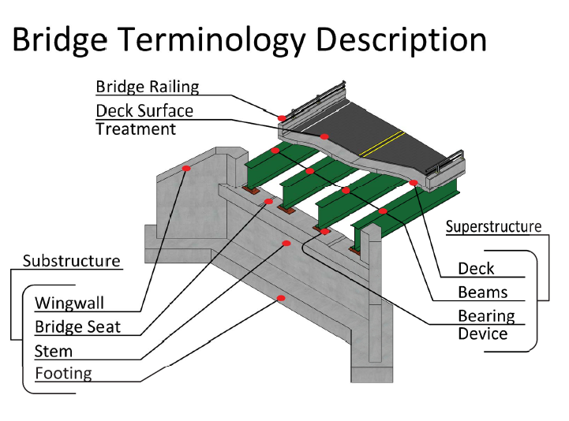
Project Overview

Slide 6
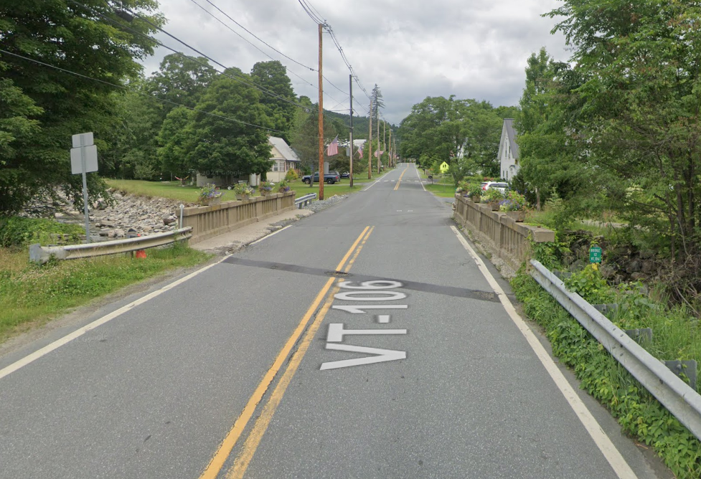
Looking North over Bridge
Bridge #12
Roadway Classification – Major Collector
Bridge Type – 52’ single span girders
Ownership – State of Vermont
Constructed in 1940

Slide 7
Existing Conditions - Bridge #12
Deck Rating 6 (Satisfactory)
Superstructure Rating 6 (Satisfactory)
Substructure Rating 6 (Satisfactory)
24-month Inspection Frequency (from June 2023)

Slide 8
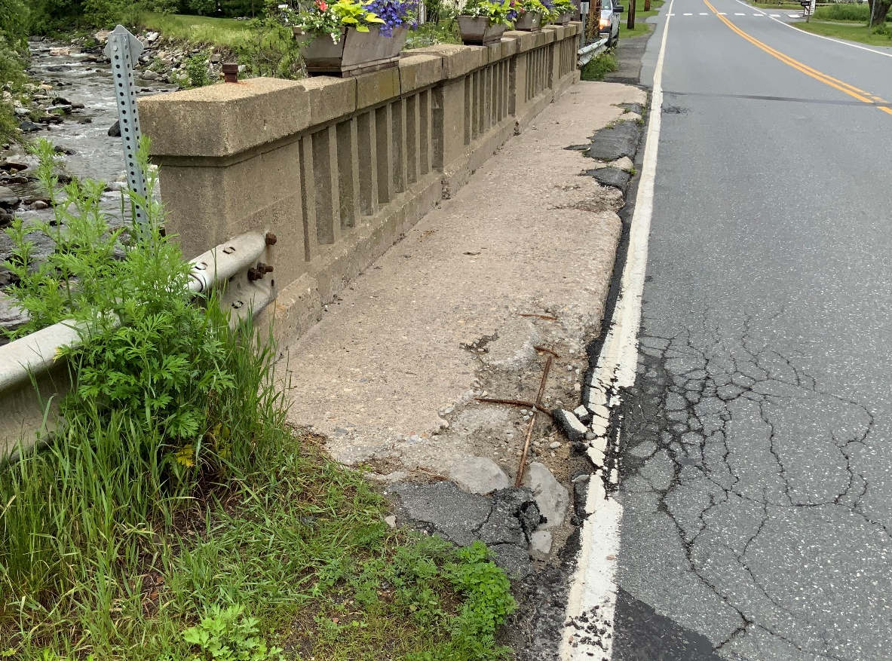
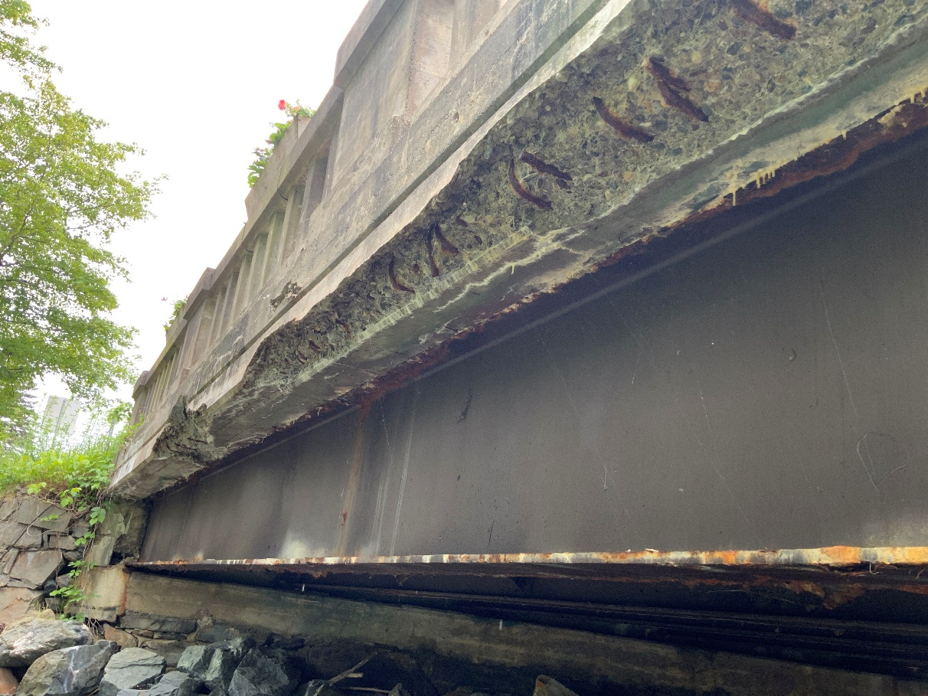
Deck - Concrete
Spalling concrete in curbs and fascia
Exposed rebar

Slide 9
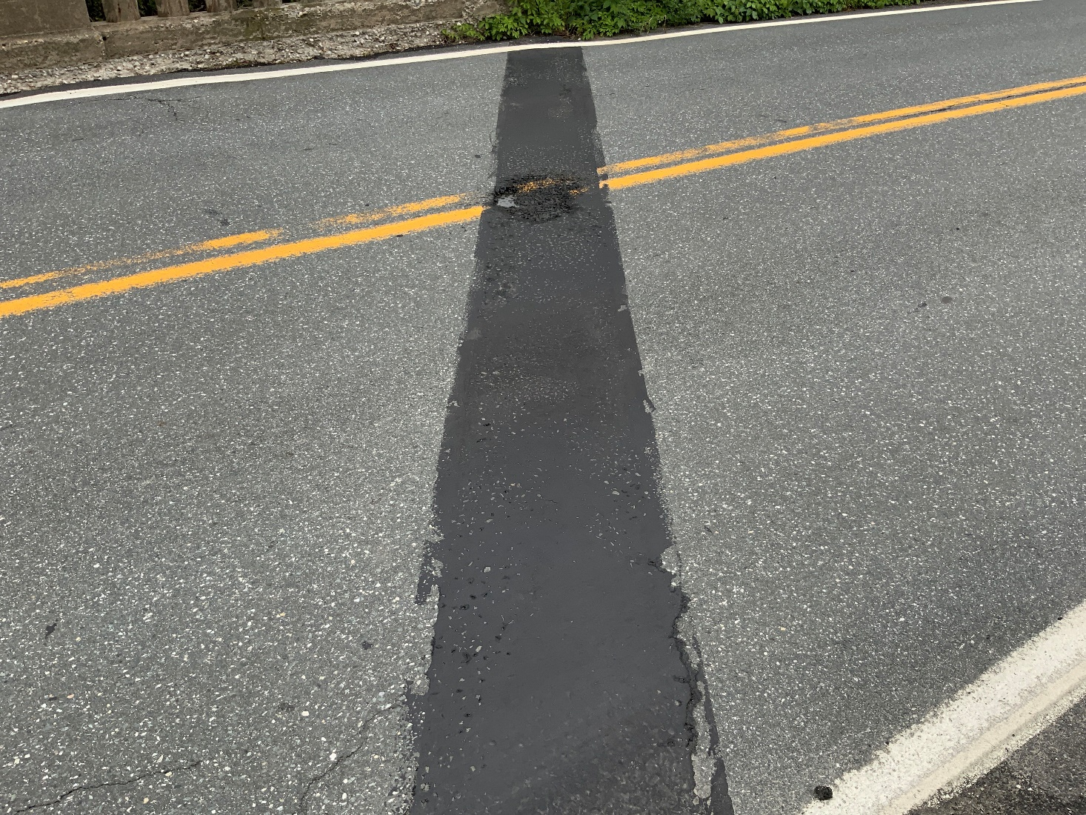
Deck - Joints
Need to be repaired as potholes have started

Slide 10
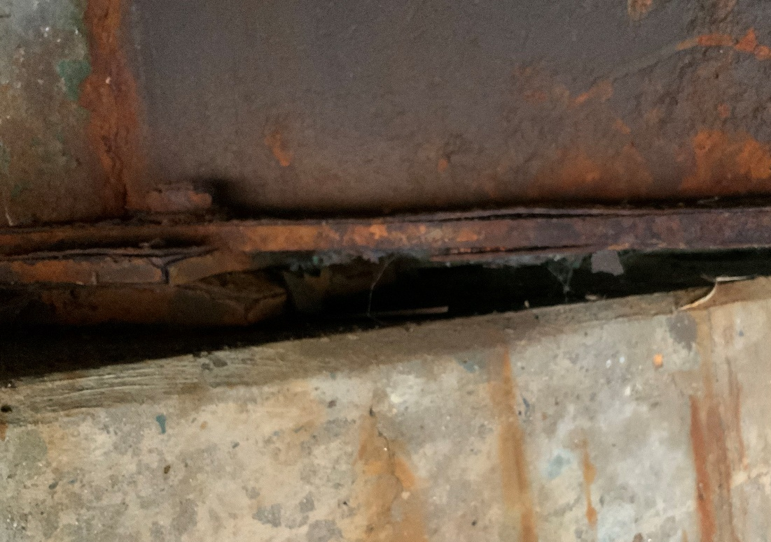

Superstructure – Steel Beams
Corrosion
Section loss

Slide 11
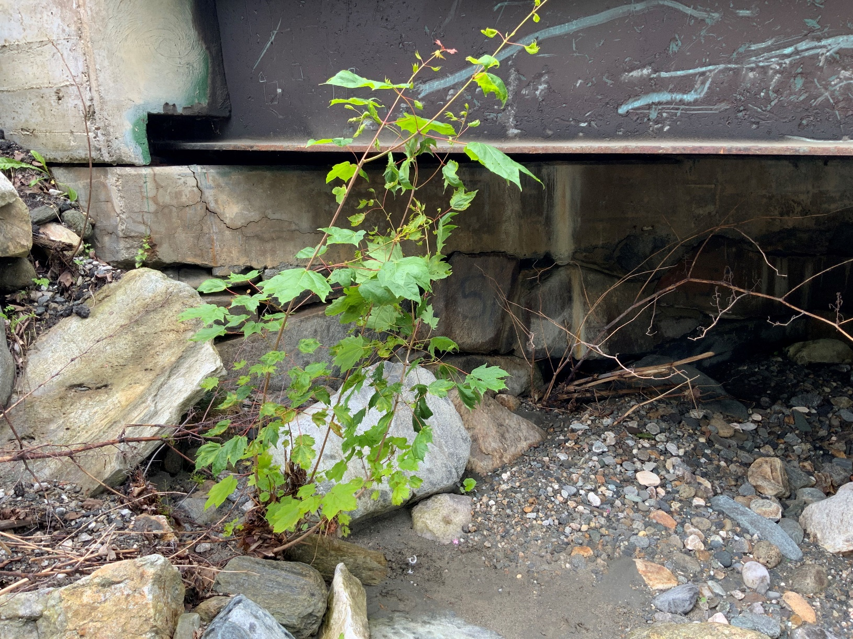
Substructure - Abutment
Minor voids, missing stones, unsure of age of stone abutment

Slide 12
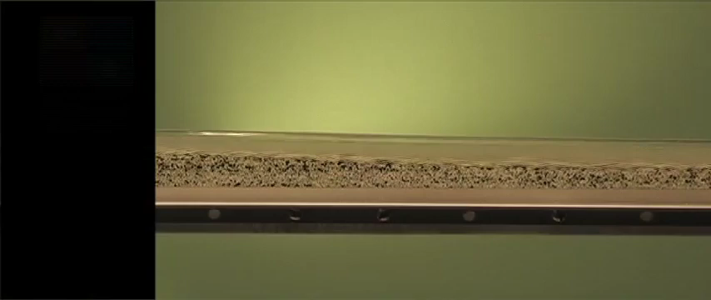
Sediment and Slope: Steep & Flatter Slopes
Bed Elevation before steepening
Original Bed
Initial Slope

Slide 13
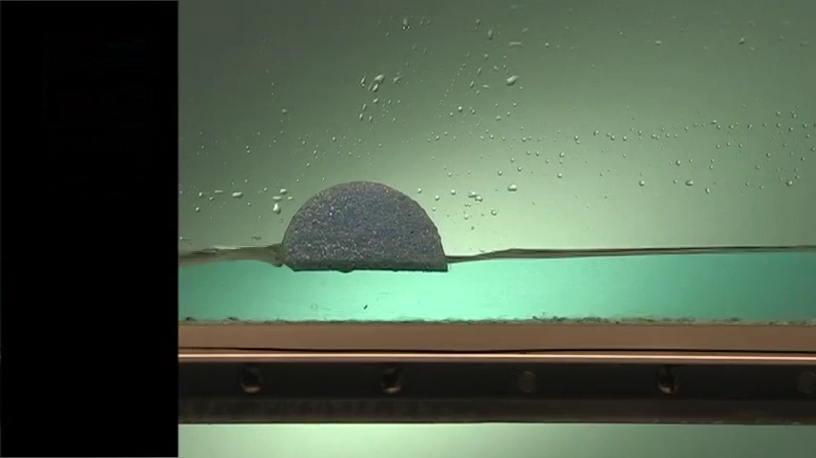
Sediment and Bridges (Flat Slope)
Original Water Surface

Slide 14
Sediment and Slope
Steep Slope
Flatter Slope

Slide 15
Hydraulic Model
What is a hydraulic model?
  A physical or mathematical representation of a flow situation
What is used to develop a hydraulic model?
  Topographic Survey , LiDAR, Aerial Photograph
  Site Visit was performed to help determine failure modes and estimate roughness parameters
What was modeled?
  A 24-hour 100-year flood event was estimated with the use of a USDA Design Rainfall Event
  Existing Site and Bridge Conditions with a moveable bed and sediment load (Sediment Transport Model)
  Hypothetical Conditions – Raised the bridge and road by 5-ft with a bridge span of approximately 70-ft

Slide 16
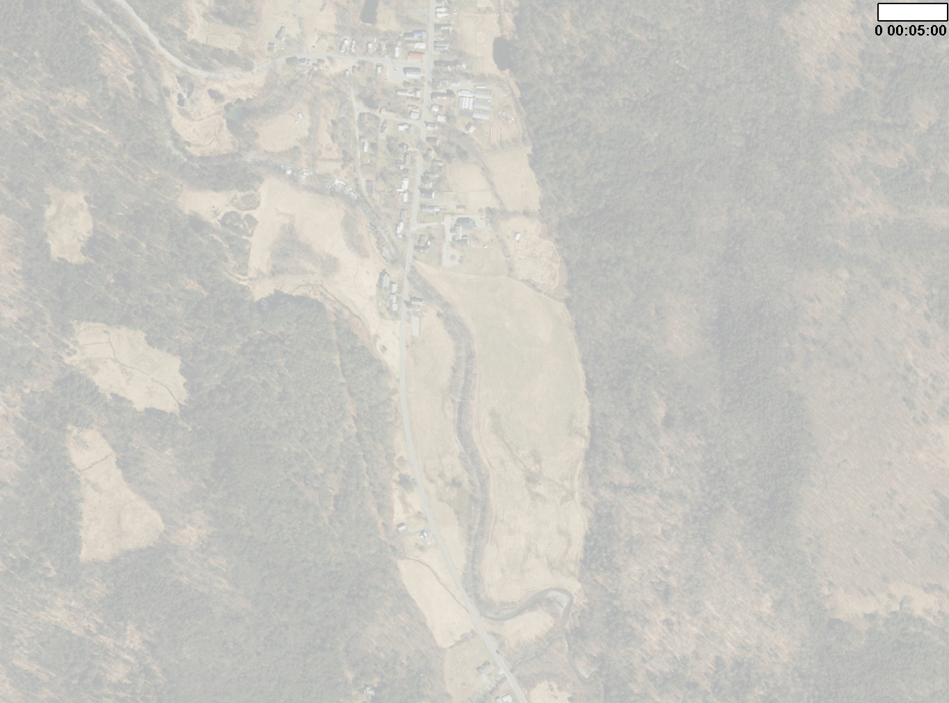
Existing Floodplain Extents
Falls
Bridge
Downstream Bend

Slide 17
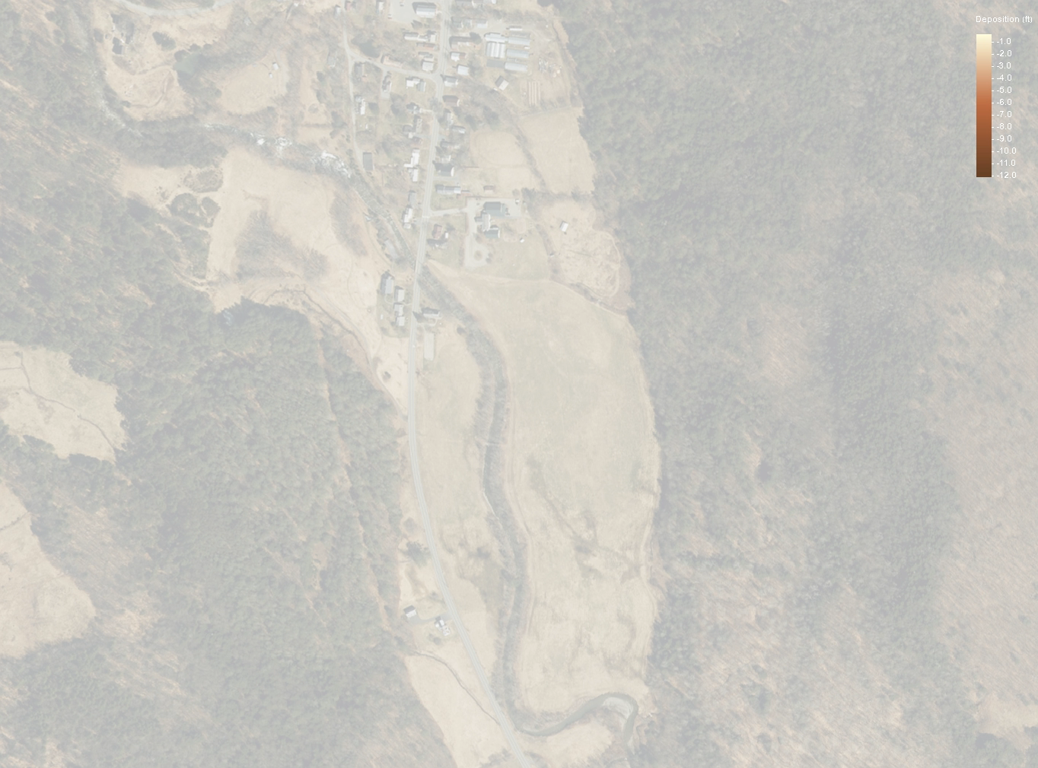
Existing Deposition
Falls
Bridge
Downstream Bend

Slide 18
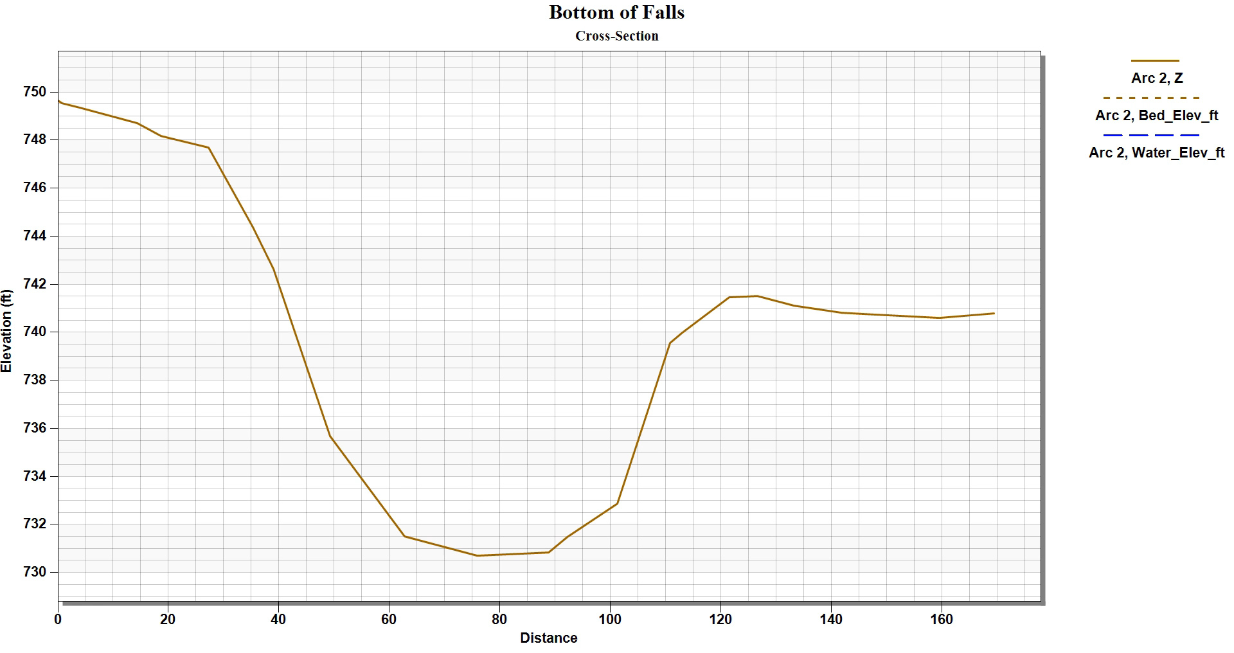
10-ft of Deposition
Falls
Bottom of Falls Location

Slide 19
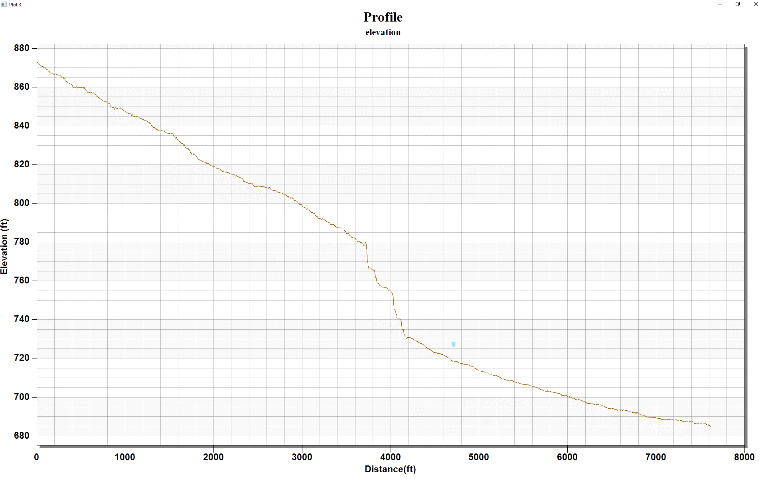
Average upstream slope
1ft drop over 39 ft +/-
Falls
Bridge Location
Downstream Bend
>40ft

Slide 20
Design Criteria and Considerations
Criteria:
  Average Daily Traffic (ADT) - 2,056 vehicles per day
  Design Hourly Volume - 258 vehicles per hour
  % Trucks: 4.7%
  Design speed of 35 mph
  Vertical sight distance standards
  Bridge width standards
  Waterway clearance and hydraulic capacity
Considered:
  Right-of-Way needed; Utility relocation needed
  Adjacent property owners and drives
  Historically sensitive properties
  Nearby elementary school

Slide 21
Alternatives Considered
No Action
  Additional maintenance required within 10 years
Rehabilitation
  Repair any spalling concrete, replace missing stone in abutments, and replacement of joints
  New sidewalk/ curbs poured
  30-year design life
Superstructure Replacement
  New girders, bearings, deck, bridge rail, and bridge joints
  Would address the maintenance issues (curb spalling, poor joints)
  40-year design life
Full Bridge Replacement
  Maintain existing alignment
  75-year design life

Slide 22
Proposed Bridge Replacement – Bridge #12
Full Bridge Replacement
    New longer and shallower superstructure with concrete deck on galvanized steel beams
    Increased hydraulic capacity
    Widen Bridge to 11’/4’ typical each side to match corridor and provide bicycle/ pedestrian shoulder accommodations
      Currently 11’/4’ (with sidewalk) on only one side and 11’/0’ other side
    Meets all geometric criteria
      Increasing sight distance
      2% roadway crown and vertical curve to promote runoff
    Integral abutments with piles driven to bedrock
      Flood resiliency
    ROW needed; Minor utility relocation
    75-year design life
    Anticipated Construction – Summer 2026

Slide 23
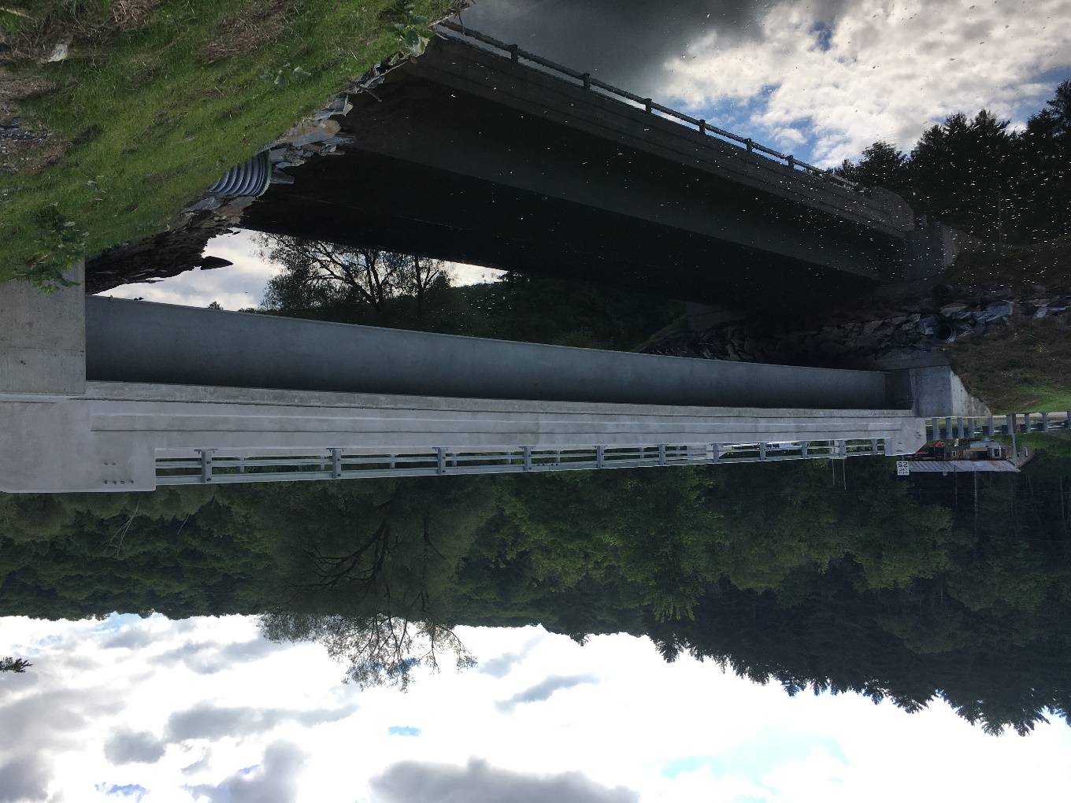
Recommended Design Alternative

Slide 24
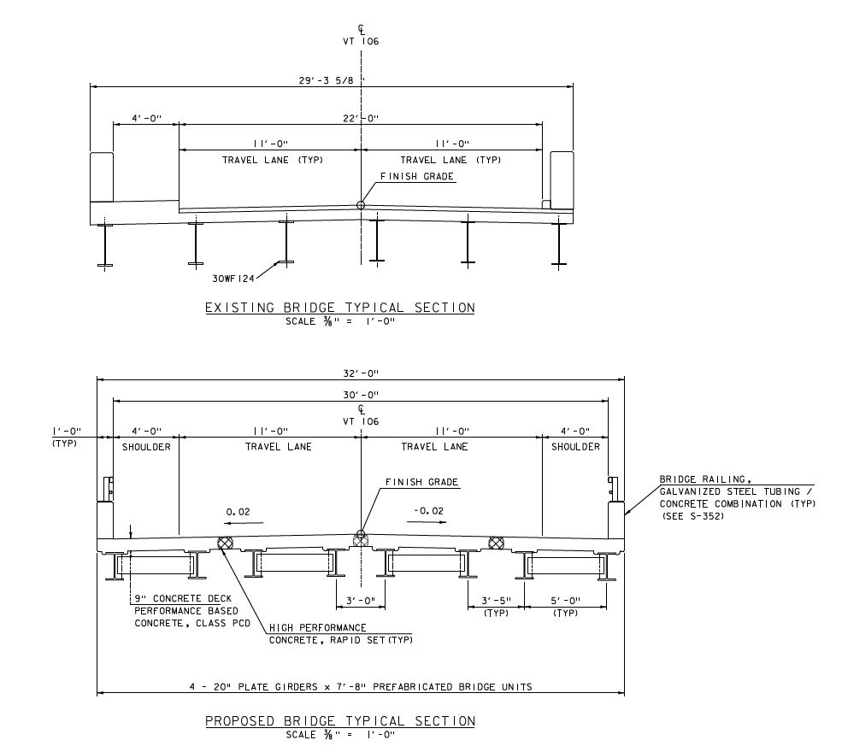
Proposed Typical Section

Slide 25
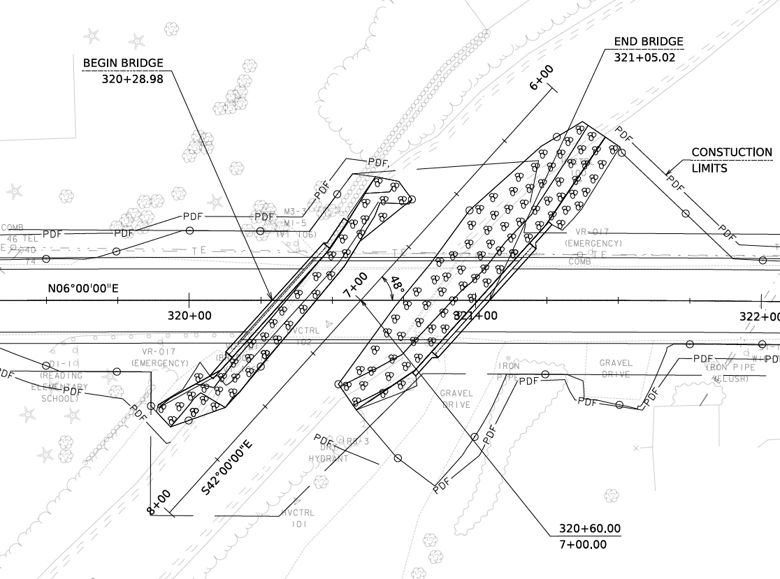
Proposed Layout

Slide 26
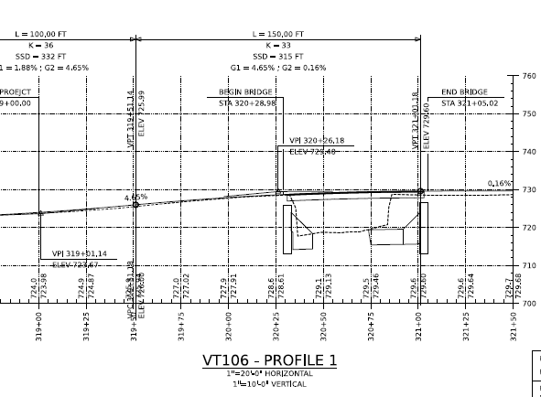
Proposed Profile

Slide 27
Maintenance of Traffic Options Considered
Temporary Bridge
Phased Construction
Road Closure with Offsite Detour and Accelerated Bridge Construction Techniques to shorten duration

Slide 28
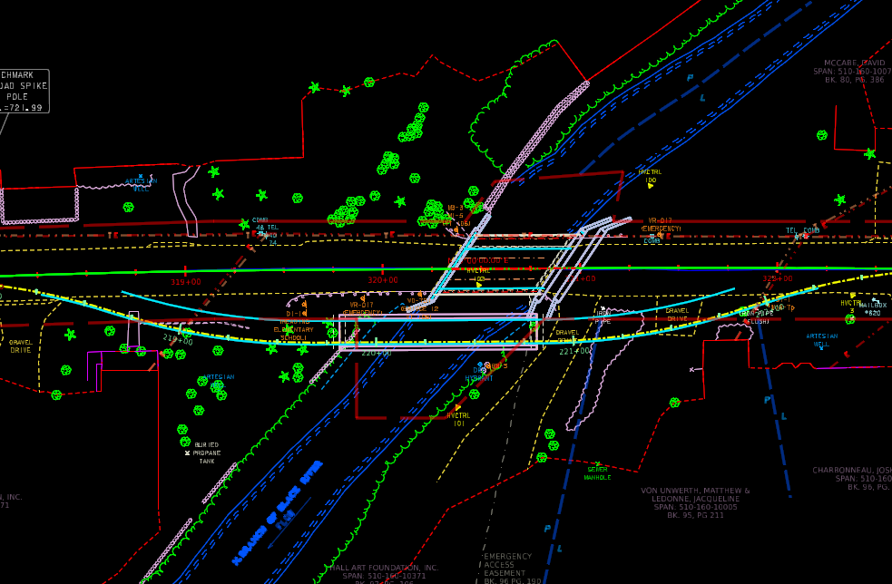
Temporary Bridge
  Layout of One Lane Temporary Bridge on downstream side

Slide 29
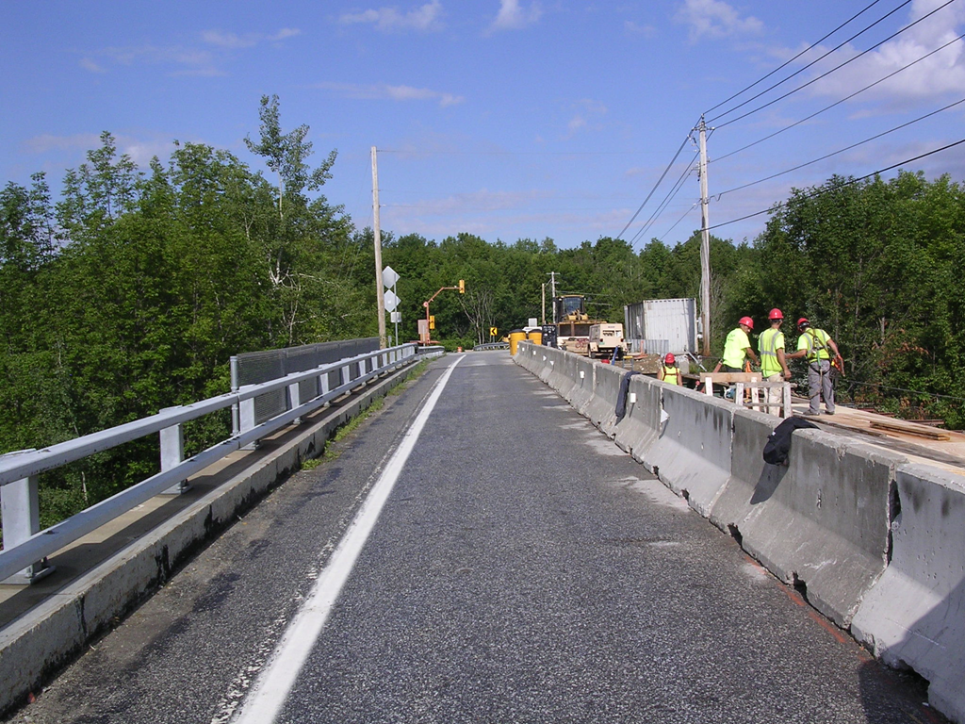
Phased Construction
  One lane traffic maintained per side
  Work Completed in 2-phases
  Tight proximity between traffic and workers
  Narrow bridge site
  Longest duration, highest cost

Slide 30
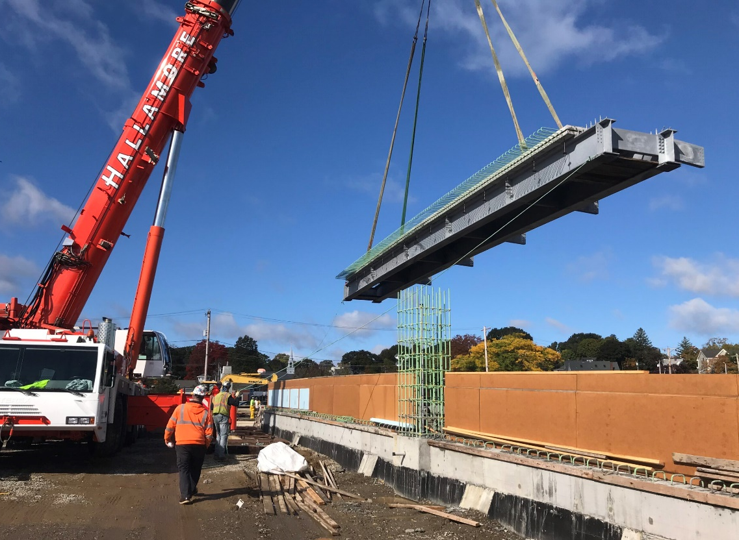
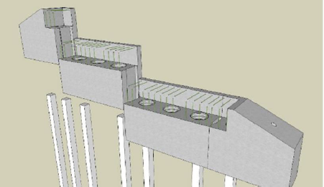
Road Closure
  Detour: chosen and signed by State
  4-week closure (Bridge replacement option)
    While school out of session
    Alternating traffic control with flaggers outside closure period
  Innovations to reduce closure duration
    Prefabricated Bridge Units (PBU’s)
    Precast abutments
  Preferred Traffic Control Option
    Safest option to keep traffic away from construction area
    Shortest construction duration
    Least expensive option
    Longest life expectancy; less maintenance

Slide 31
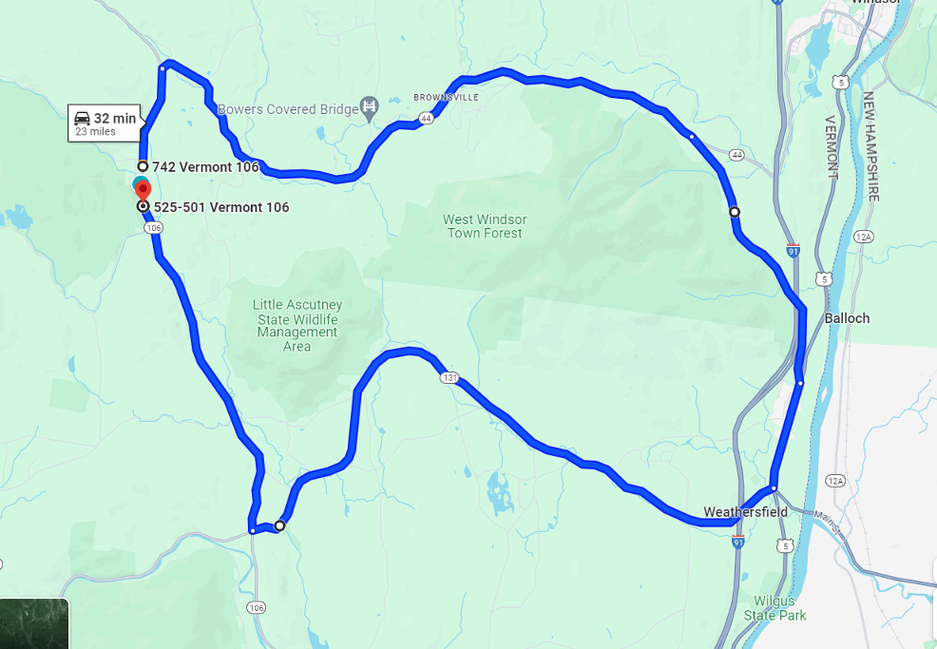
Traffic Control – Offsite Detour
  End to end: 32 minutes (23 miles)
  Through detour: 27 minutes (18 miles)
  VT 44 to VT 44A to US-5 to VT-131

Slide 32
Project Schedule
Reading ER P23-1(404) Development Schedule
Scoping | Complete
Conceptual Plans | Complete
Preliminary Plans | Fall/Winter 2024
Permitting | Summer 2025
Final Plans | Summer 2025
Right-of-Way Clear | Fall 2025
Contract Plans | October 2025
Bid Advertisement | November 2025
Construction | April 2026 – October 2026 (Bridge closure 4 weeks during summer months while school out of session. Alternating one-way traffic with flaggers before and after closure period)

Slide 33
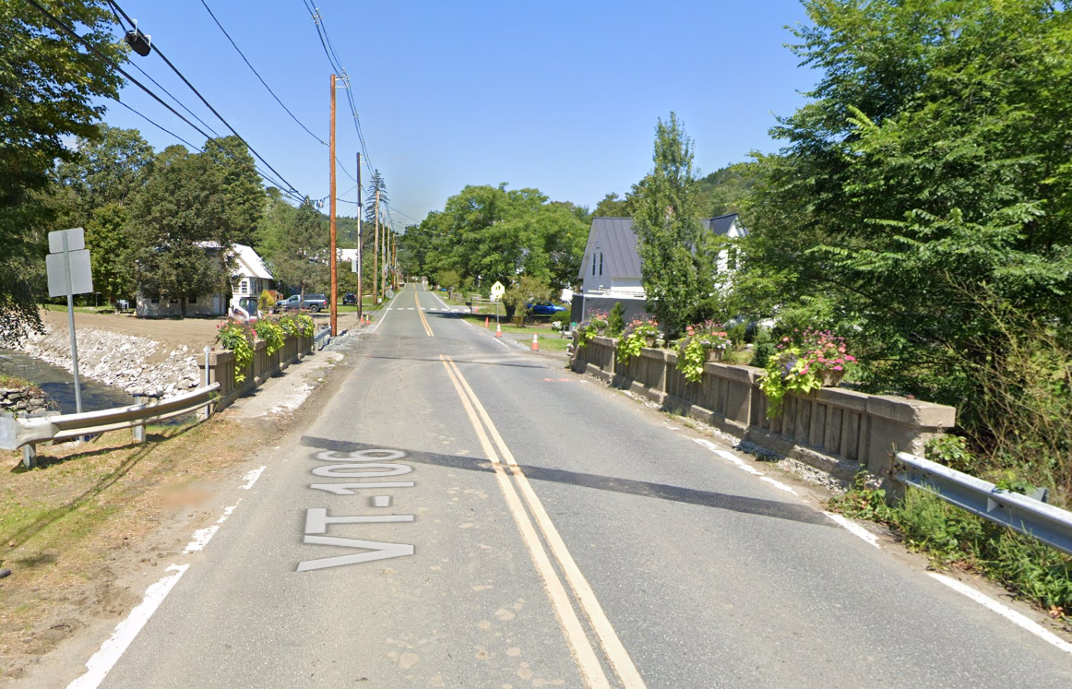
For more information:
https://outside.vermont.gov/agency/vtrans/external/Projects/Structures/23b770
Reading ER P23-1(404)
Questions and Comments
VT 106 – Bridge #12 over North Branch Black River
September 9, 2024

